Slide 1
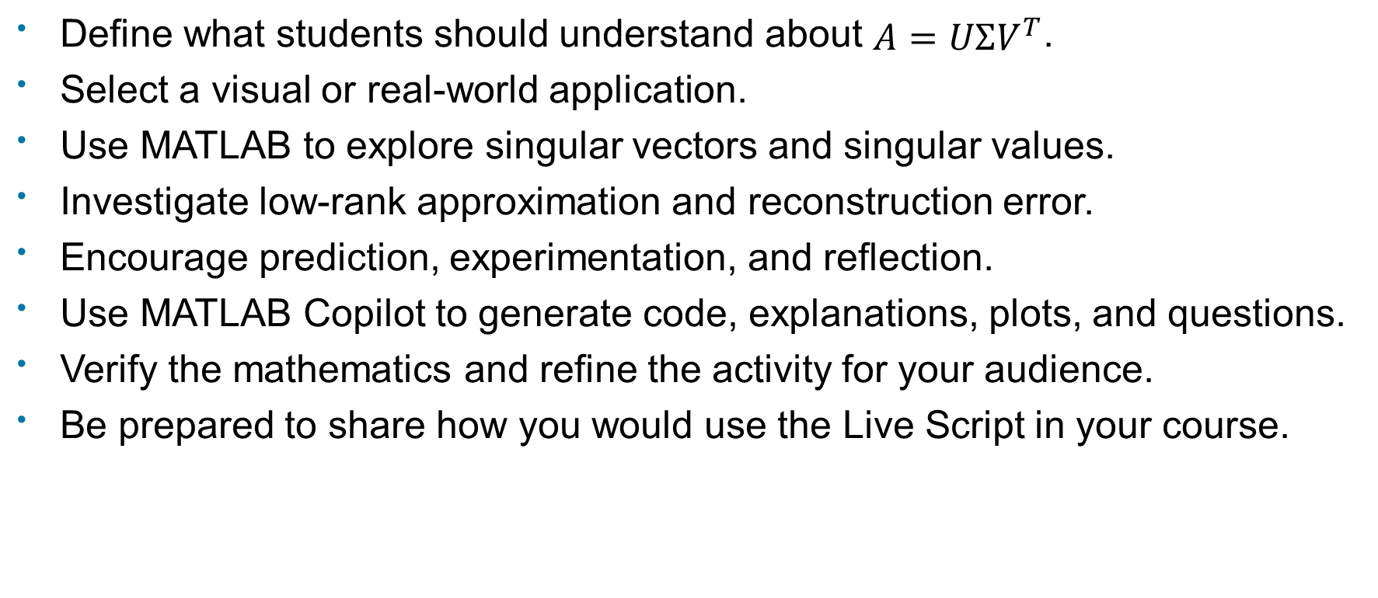
Create an Interactive SVD Learning Experience
Define what students should understand about $A=UΣV^{T}$.
Select a visual or real-world application.
Use MATLAB to explore singular vectors and singular values.
Investigate low-rank approximation and reconstruction error.
Encourage prediction, experimentation, and reflection.
Use MATLAB Copilot to generate code, explanations, plots, and questions.
Verify the mathematics and refine the activity for your audience.
Be prepared to share how you would use the Live Script in your course.

